Slide 1
Algorithms and Data Structures
Lecture XIII
Simonas Šaltenis
Nykredit Center for Database Research
Aalborg University
simas@cs.auc.dk

Slide 2
This Lecture
Single-source shortest paths in weighted graphs
  Shortest-Path Problems
  Properties of Shortest Paths, Relaxation
  Dijkstra’s Algorithm
  Bellman-Ford Algorithm
  Shortest-Paths in DAG’s

Slide 3

Shortest Path
Generalize distance to weighted setting
Digraph G = (V,E) with weight function W: E → R (assigning real values to edges)
Weight of path p = v₁ → v₂ → … → v_{k} is
Shortest path = a path of the minimum weight
Applications
  static/dynamic network routing
  robot motion planning
  map/route generation in traffic

Slide 4
Shortest-Path Problems
Shortest-Path problems
  Single-source (single-destination). Find a shortest path from a given source (vertex s) to each of the vertices. The topic of this lecture.
  Single-pair. Given two vertices, find a shortest path between them. Solution to single-source problem solves this problem efficiently, too.
  All-pairs. Find shortest-paths for every pair of vertices. Dynamic programming algorithm.
  Unweighted shortest-paths – BFS.

Slide 5

Optimal Substructure
Theorem: subpaths of shortest paths are shortest paths
Proof (cut and paste)
  if some subpath were not the shortest path, one could substitute the shorter subpath and create a shorter total path

Slide 6
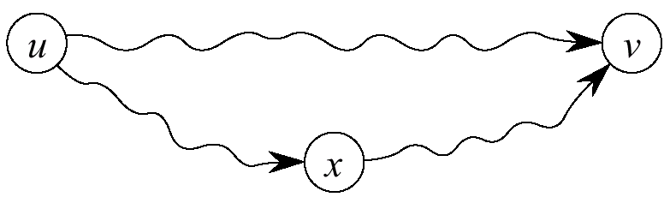
Triangle Inequality
Definition
  δ(u,v) ≡ weight of a shortest path from u to v
Theorem
  δ(u,v) ≤ δ(u,x) + δ(x,v) for any x
Proof
  shortest path u  v is no longer than any other path u  v – in particular, the path concatenating the shortest path u  x with the shortest path x  v

Slide 7
Negative Weights and Cycles?
Negative edges are OK, as long as there are no negative weight cycles (otherwise paths with arbitrary small “lengths” would be possible)
Shortest-paths can have no cycles (otherwise we could improve them by removing cycles)
  Any shortest-path in graph G can be no longer than n – 1 edges, where n is the number of vertices

Slide 8
Relaxation
For each vertex in the graph, we maintain d[v], the estimate of the shortest path from s, initialized to ∞ at start
Relaxing an edge (u,v) means testing whether we can improve the shortest path to v found so far by going through u
u
v
u
v
Relax (u,v,w)
if d[v] > d[u]+w(u,v)then
d[v] ← d[u]+w(u,v)
π[v] ← u
2
2
5
9
5
6
Relax(u,v)
Relax(u,v)
5
7
5
6
2
2
u
v
u
v

Slide 9
Dijkstra's Algorithm
Non-negative edge weights
Greedy, similar to Prim's algorithm for MST
Like breadth-first search (if all weights = 1, one can simply use BFS)
Use Q, priority queue keyed by d[v] (BFS used FIFO queue, here we use a PQ, which is re-organized whenever some d decreases)
Basic idea
  maintain a set S of solved vertices
  at each step select "closest" vertex u, add it to S, and relax all edges from u

Slide 10

Dijkstra’s Pseudo Code
Graph G, weight function w, root s
relaxing edges

Slide 11
Dijkstra’s Example
u
v
u
v
1
1
10
∞
∞
10
10
∞
9
9
s
0
2
3
s
0
2
3
4
6
4
6
7
7
5
5
∞
∞
5
∞
2
2
x
y
x
y
u
v
u
v
1
1
8
14
10
8
13
10
9
9
2
3
s
0
2
3
s
0
4
6
4
6
7
7
5
5
5
7
5
7
2
2
x
y
x
y

Slide 12
Dijkstra’s Example (2)
u
v
u
v
1
1
Observe
  relaxation step (lines 10-11)
  setting d[v] updates Q (needs Decrease-Key)
  similar to Prim's MST algorithm
10
8
9
10
8
9
9
9
0
2
3
0
2
3
4
6
4
6
7
7
5
5
5
7
5
7
2
2
x
y
x
y

Slide 13
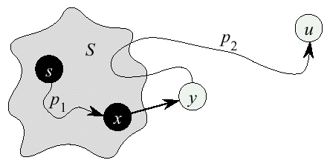
Dijkstra’s Correctness
We will prove that whenever u is added to S, d[u] = δ(s,u), i.e., that d is minimum, and that equality is maintained thereafter
Proof
  Note that ∀v, d[v] ≥ δ(s,v)
  Let u be the first vertex picked such that there is a shorter path than d[u], i.e., that ⇒ d[u] > δ(s,u)
  We will show that this assumption leads to a contradiction

Slide 14
Dijkstra Correctness (2)
Let y be the first vertex ∈V – S on the actual shortest path from s to u, then it must be that d[y] = δ(s,y) because
  d[x] is set correctly for y's predecessor x ∈S on the shortest path (by choice of u as the first vertex for which d is set incorrectly)
  when the algorithm inserted x into S, it relaxed the edge (x,y), assigning d[y] the correct value

Slide 15
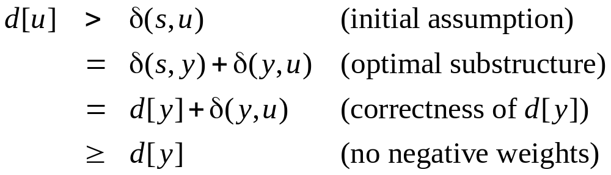
Dijkstra Correctness (3)
But d[u] > d[y] ⇒ algorithm would have chosen y (from the PQ) to process next, not u ⇒ Contradiction
Thus d[u] = δ(s,u) at time of insertion of u into S, and Dijkstra's algorithm is correct

Slide 16
Dijkstra’s Running Time
Extract-Min executed |V| time
Decrease-Key executed |E| time
Time = |V| T_{Extract-Min} + |E| T_{Decrease-Key}
T depends on different Q implementations
Q | T(Extract-Min) | T(Decrease-Key) | Total
array | Ο(V) | Ο(1) | Ο(V ²)
binary heap | Ο(lg V) | Ο(lg V) | Ο(E lg V)
Fibonacci heap | Ο(lg V) | Ο(1) (amort.) | Ο(V lgV + E)

Slide 17
Bellman-Ford Algorithm
Dijkstra’s doesn’t work when there are negative edges:
  Intuition – we can not be greedy any more on the assumption that the lengths of paths will only increase in the future
Bellman-Ford algorithm detects negative cycles (returns false) or returns the shortest path-tree

Slide 18
Bellman-Ford Algorithm
Bellman-Ford(G,w,s)
01 for each v ∈ V[G]
02 d[v] ← ∞
03 d[s] ← 0
04 π[s] ← NIL
05 for i ← 1 to |V[G]|-1 do
06 for each edge (u,v) ∈ E[G] do
07 Relax (u,v,w)
08 for each edge (u,v) ∈ E[G] do
09 if d[v] > d[u] + w(u,v) then return false
10 return true

Slide 19
Bellman-Ford Example
t
5
x
t
5
x
∞
-2
∞
6
-2
∞
6
6
-3
-3
s
0
8
s
0
8
-4
7
-4
7
2
2
7
7
∞
∞
7
∞
9
9
y
z
y
z
t
5
x
t
5
x
6
-2
4
2
-2
4
6
6
-3
-3
s
0
8
s
0
8
-4
7
-4
7
2
2
7
7
7
2
7
2
9
9
y
z
y
z

Slide 20
Bellman-Ford Example
t
5
x
2
-2
4
6
-3
s
0
8
-4
7
2
7
7
−2
9
y
z
Bellman-Ford running time:
  (|V|-1)|E| + |E| = Θ(VE)

Slide 21
Correctness of Bellman-Ford
Let δ_{i}(s,u) denote the length of path from s to u, that is shortest among all paths, that contain at most i edges
Prove by induction that d[u]= δ_{i}(s,u) after the i-th iteration of Bellman-Ford
  Base case (i=0) trivial
  Inductive step (say d[u] = δ_{i-1}(s,u)):
    Either δ_{i}(s,u) = δ_{i-1}(s,u)
    Or δ_{i}(s,u) = δ_{i-1}(s,z) + w(z,u)
    In an iteration we try to relax each edge ((z,u) also), so we will catch both cases, thus d[u] = δ_{i}(s,u)

Slide 22
Correctness of Bellman-Ford
After n-1 iterations, d[u] = δ_{n-1}(s,u), for each vertex u.
If there is still some edge to relax in the graph, then there is a vertex u, such that δ_{n}(s,u) < δ_{n-1}(s,u). But there are only n vertices in G – we have a cycle, and it must be negative.
Otherwise, d[u]= δ_{n-1}(s,u) = δ(s,u), for all u, since any shortest path will have at most n-1 edges

Slide 23
Shortest-Path in DAG’s
Finding shortest paths in DAG’s is much easier, because it is easy to find an order in which to do relaxations – Topological sorting!
DAG-Shortest-Paths(G,w,s)
01 for each v ∈ V[G]
02 d[v] ← ∞
03 d[s] ← 0
04 topologically sort V[G]
05 for each vertex u, taken in topolog. order do
06 for each vertex v ∈ Adj[u] do
07 Relax(u,v,w)

Slide 24
Shortest-Paths in DAG’s (2)
Running time:
  Θ(V+E) – only one relaxation for each edge, V times faster than Bellman-Ford

Slide 25
Next Lecture
Introduction to Computational Geometry

